Slide 1
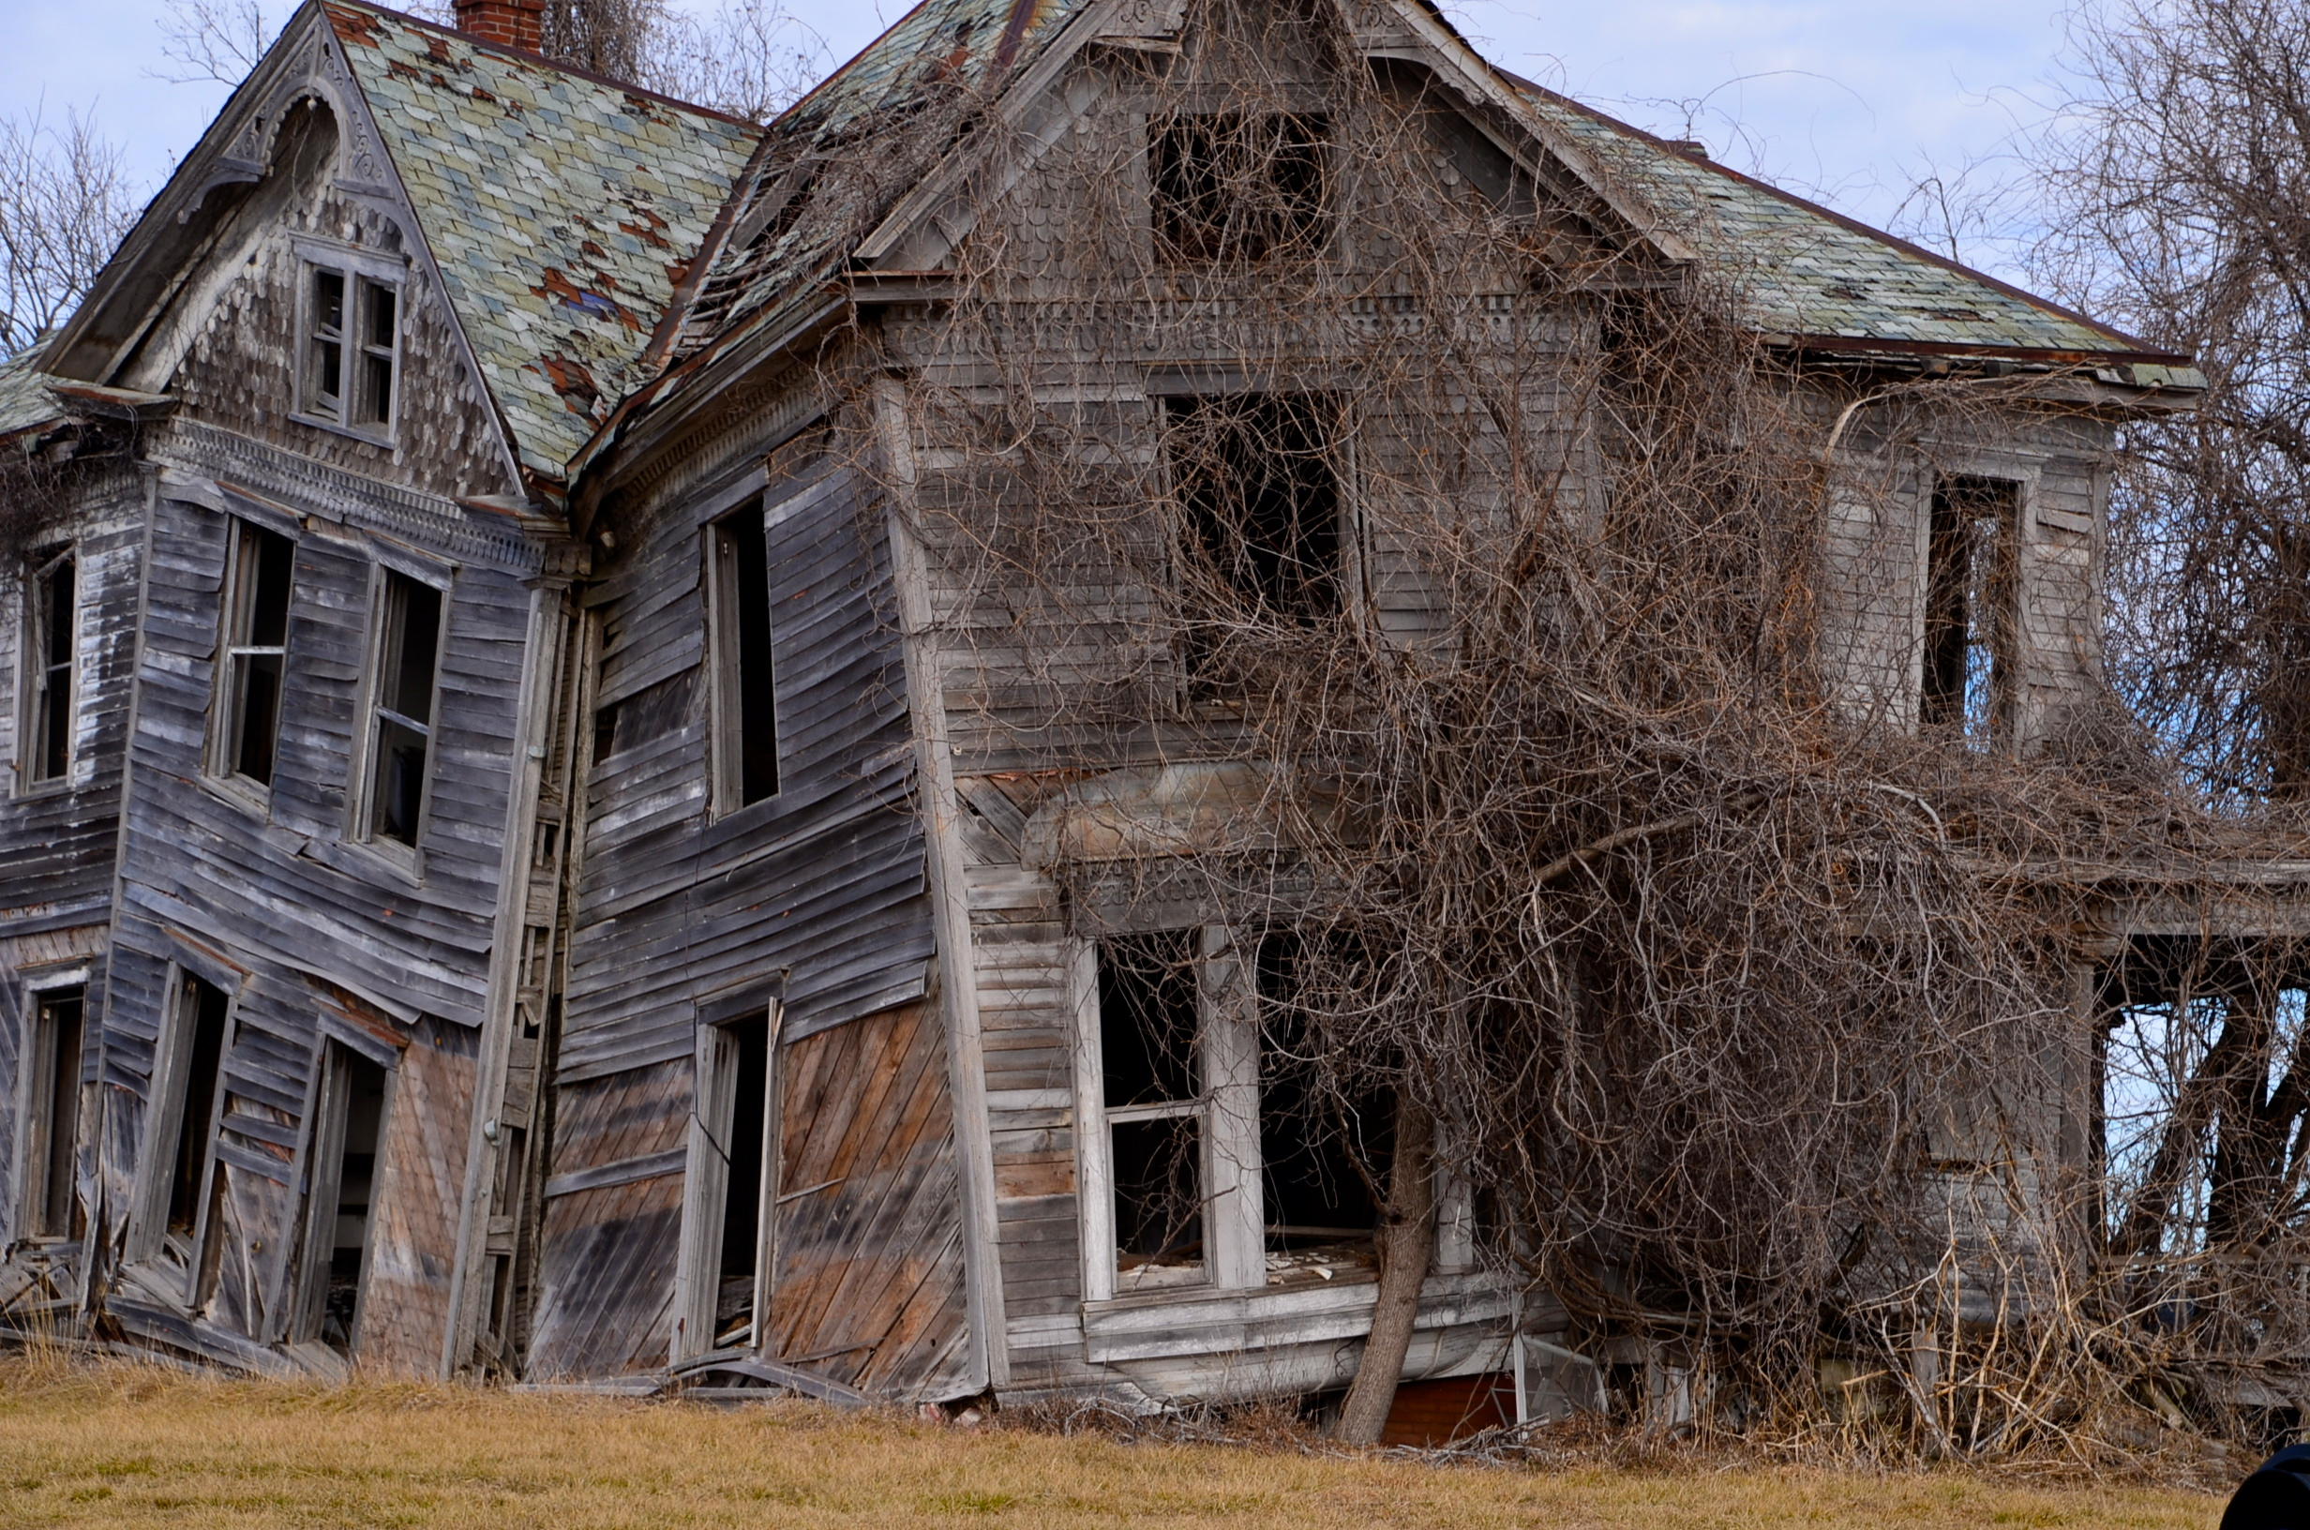
Build systems
A simple solution
To a complicated problem

Slide 2
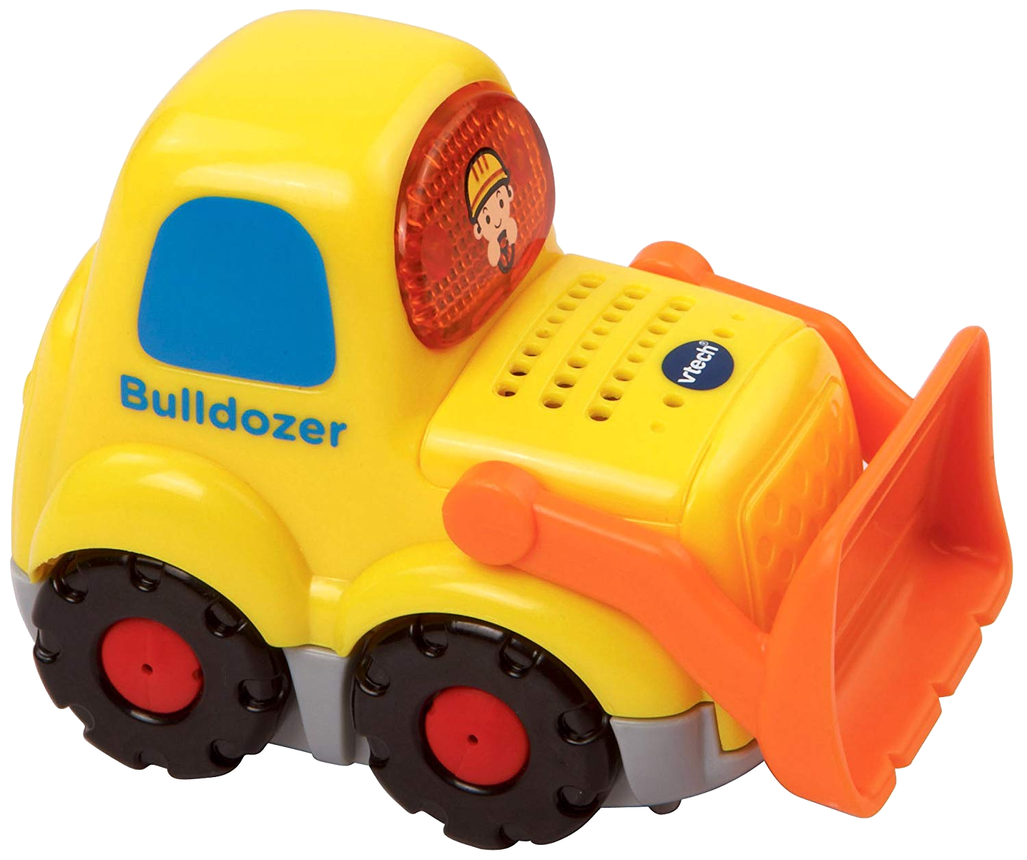
Simple solution

Slide 3
Who are we doing this for

Slide 4

The creator of autotools?

Slide 5

Build-tool specific experts?
Source:
CppCast,
Jussi Pakkanen,
Meson author

Slide 6
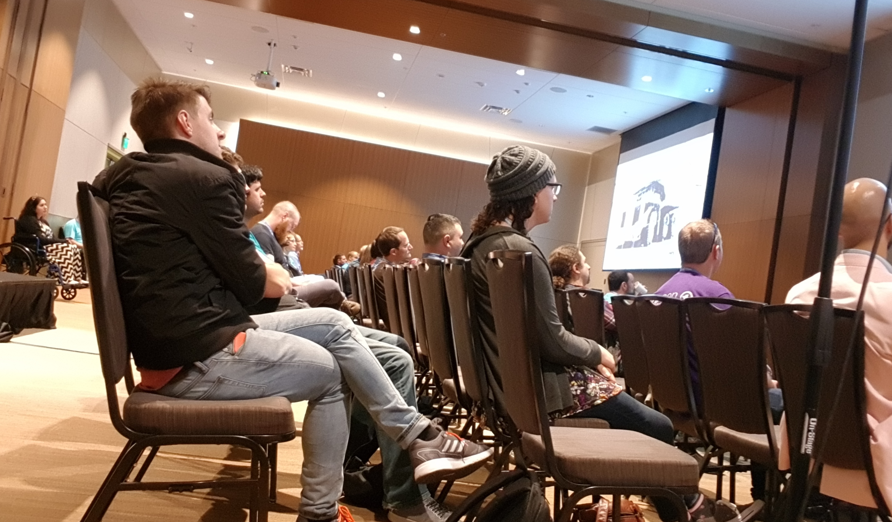
People that attend conferences?

Slide 7
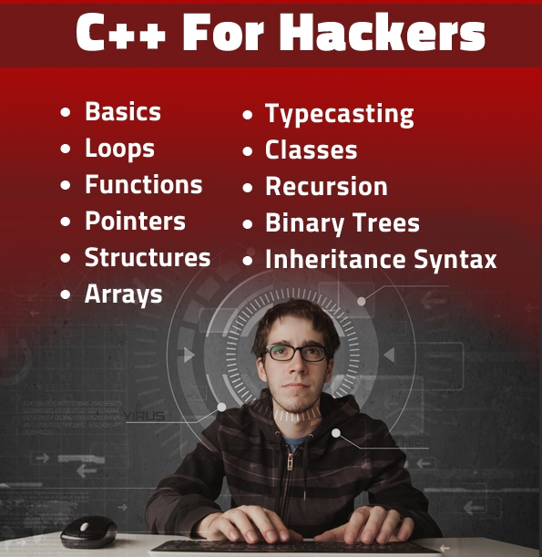
Familiar with the language?
Source:
http://www.hackinsight.org/free-content,33.html

Slide 8

New to the language
Source: Pixnio.com

Slide 9

New to programming entirely

Slide 10
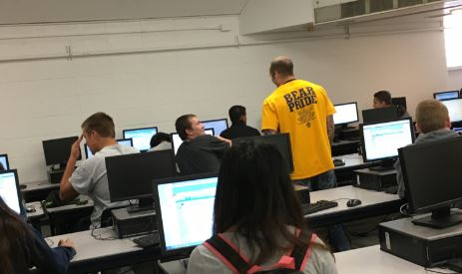
Students seeing a compiler for the first time in their life

Slide 11

Children learning new skills

Slide 12


Slide 13
My target
You can read and write
You can understand English keywords
  Somewhat
You have a computer
  But a 10-year old computer should suffice
Notes:
5 min in

Slide 14
My target
Make it really simple to start
Allow the users to learn beyond
Offer a cheap and smooth upgrade path

Slide 15
Simplicity
You saw Kate’s talk yesterday
  “Is this really all I need to change?”

Slide 16
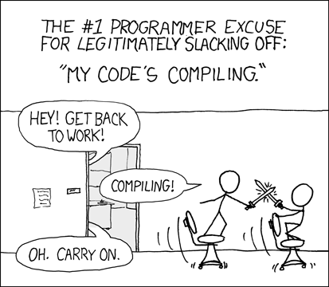
© XKCD,
Randall Munroe

Slide 17
The parts of a build
Build system driver
Dependency derivation
Package retrieval
Creating commands
Package info
Running commands

Slide 18
Way before time began
Manual labor
Manual labor
Manual labor
Manual labor
Global install
Manual labor

Slide 19
Way before time began
Manual labor
Manual labor
Manual labor
Manual labor
Global install
Shell script

Slide 20
The Make era
Manual labor
Manual labor
Manual labor
Make
Global install / pkg-config
Make

Slide 21
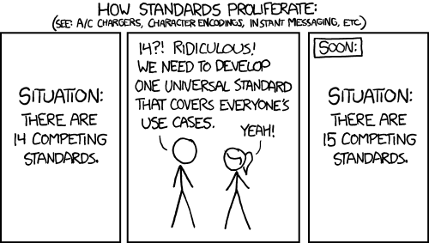
© XKCD,
Randall Munroe

Slide 22
All the makes
bmake
cmake
dmake
emake
fmake
gmake
hmake
imake
jmake
kmake
mmake
nmake
omake
pmake
qmake
rmake
smake
tmake
umake
vmake
wmake
xmake
ymake
zmake

Slide 23
If you want to make another make
amake
lmake
  Not to be confused with imake, of course
But my list is from 2011, so maybe not
What about 😃make ?

Slide 24
The Cmake era
Manual labor
Manual labor
Manual labor
CMake
Cmake / pkg-config
Make

Slide 25
Beyond make
Manual labor
Manual labor
Manual labor
CMake
Cmake / pkg-config
Ninja

Slide 26
Recent history
Shell script
Cpp-dependencies
Vcpkg?
CMake
Cmake / pkg-config
Ninja

Slide 27
Vcpkg?
Pkg-config / vcpkg info

Slide 28
Why do build systems always tend to complexity
Notes:
10 min in

Slide 29

All the corner cases

Slide 30

All the corner cases

Slide 31
Total build sequence
Build object files
Pack static libraries
Link executables
Link shared libraries
Run unit tests
Run code formatter

Slide 32
Total build sequence
Build object files
Pack static libraries
Link executables
Link shared libraries
Run unit tests
Run code formatter
Run static code analysis

Slide 33
Total build sequence
Build object files
Pack static libraries
Link executables
Link shared libraries
Run unit tests
Run code formatter
Run static code analysis
Upload to embedded target
Send to binary package repository
Download code from git
Update version file & commit
Git submodule init
Git submodule update
Automated merge of new commits
Create release notes
Announce on twitter
Wget script | sudo bash -c
And more!

Slide 34
Modules

Slide 35
What are modules
From build system point of view

Slide 36
Generated code
Generated source files
Having your source generator part of the same build
That depends on some other generated file itself
Recursively repeated.

Slide 37
Build system types
Procedural
Functional
Declarative / descriptive
Prescriptive / Generative
Notes:
15 min in

Slide 38
Procedural
Your build steps
In the order
To run them

Slide 39
Procedural
Simple to grasp
Can be reliable

Slide 40
Procedural
100% manual scripting
  Omissions
  Bugs
  Typos
  Unintended deviations

Slide 41
Procedural
Requires full knowledge of compile process
No parallelism
No incremental compilation
Very easy to mess up

Slide 42
Functional
Define how to derive the build steps
Let the build system figure out what follows
Excellent if compile steps and tools vary a lot

Slide 43
Functional
Handles incremental builds
Can be very reliable
  But make doesn’t warn if you mess it up
Portable
  (arguably)

Slide 44
Functional
Nowadays very unpopular
Really hard to diagnose and fix
Implementation incompatibility

Slide 45


Slide 46
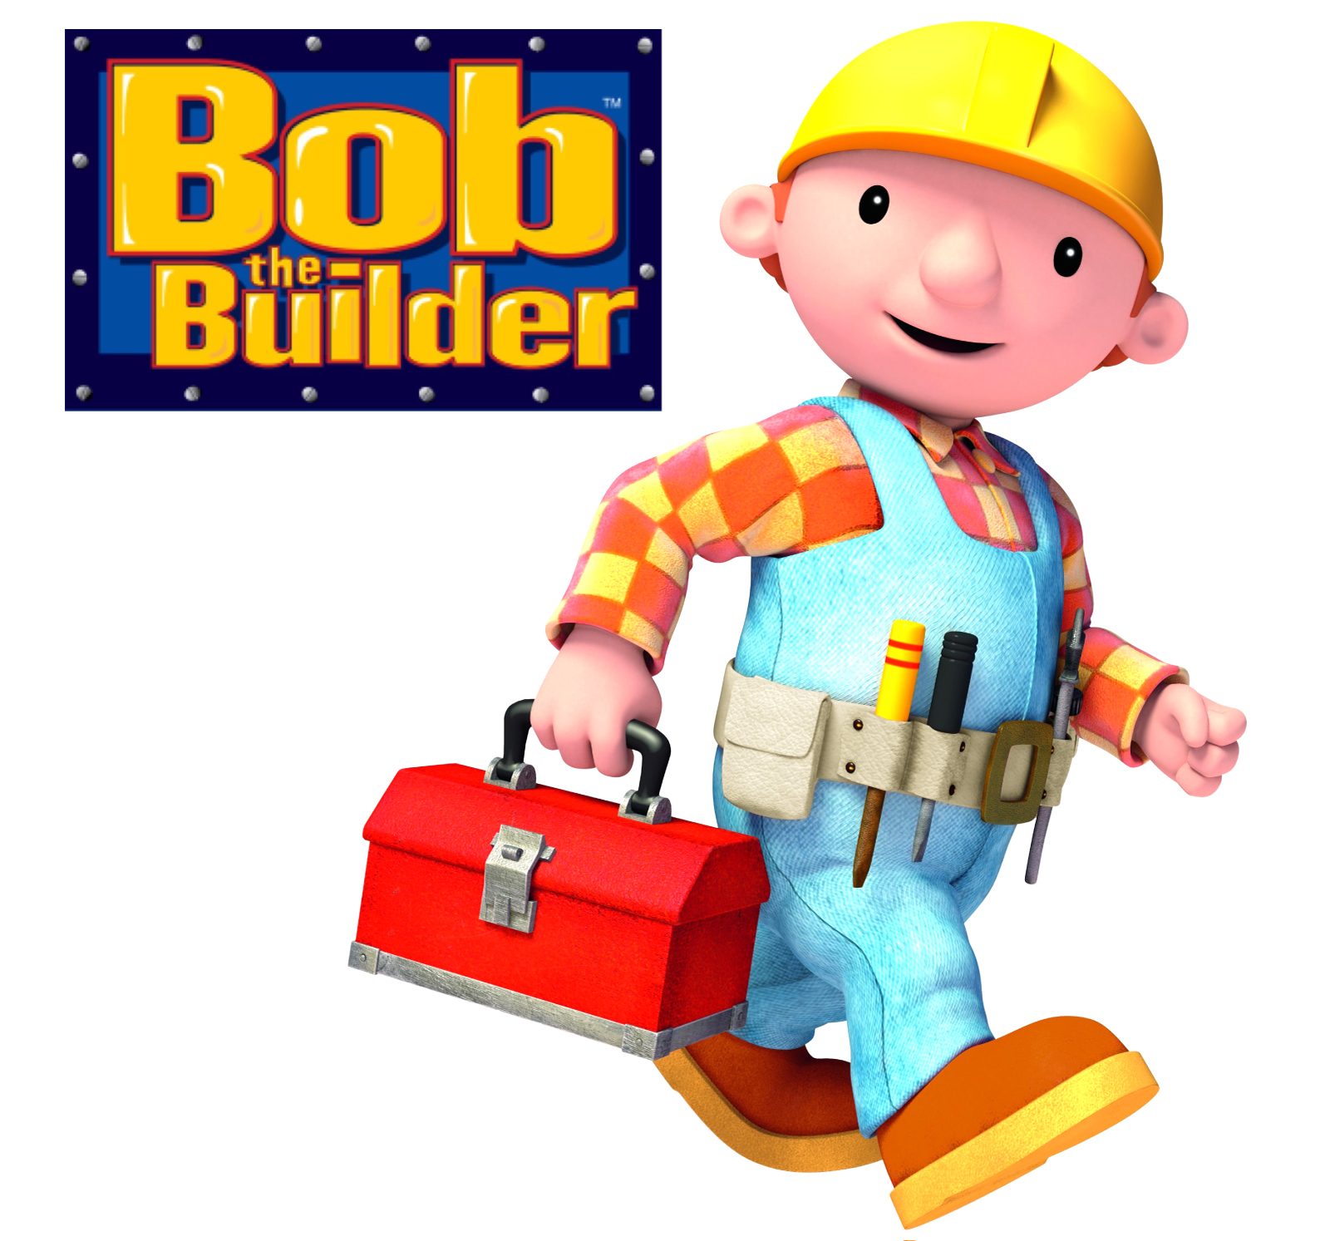

Slide 47
Functional
No good solution for dependencies
Minor historical limitations
Notes:
20 min in

Slide 48
Declarative / Descriptive
Most build systems
About as verbose as the build script
Allows arbitrary scripting

Slide 49
Who here has seen build scripts
Special cases in some targets
Custom hacks
// TODO: remove this in 5 years
// 2005-06-28 Temporary hack

Slide 50
Who knows FOR SURE that you don’t have this?
Remember that you can override - for example - add_library in cmake to do something else entirely.
This could be in somebody else’s scripts that you include

Slide 51
Prescriptive/Generative
Instead of writing down what to build, derive what to build
Allow minimal room for adjustments and exceptions
  Nobody else can either

Slide 52
Prescriptive/Generative
Complicated build tool
Requires knowledge of what the tool expects

Slide 53

So how do we break the cycle of complexity?

Slide 54
Explicitly target beginners
Very little configuration required
  To compile your Hello World it should require absolutely no configuration.
  As far as is reasonably possible, it should require no configuration.
  If there is configurability, it should be restricted to acceptable minor adjustments.
    Name and type of component

Slide 55
Explicitly target beginners
Limit creativity
  Make it not turing complete.
Notes:
- Turing complete sounds like a good thing, but (very shorthand) it denotes "arbitrary complexity can be shoved in here". It is a desirable thing to *not* have.

Slide 56
Explicitly target beginners
Clearly delineate what the tool will accomodate, and what it will not.
Limit deployment type proliferation
Error for build-breaking conditions
Warn for things that cause build-breaking conditions
Notes:
Clearly delineate what the tool will accomodate, and what it will not.
Include all the deployment that's needed for beginners, but omit any advanced building logic in that.
Make the build tool explicitly indicate when you are creating situations that are likely to break a build, before they cause a hard-to-fix broken build.

Slide 57
Make it prescriptive
Make it generative

Slide 58
Why do prescriptive systems fail
People hate changing habits
People dislike being prescribed things

Slide 59
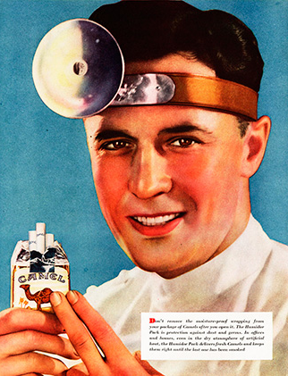
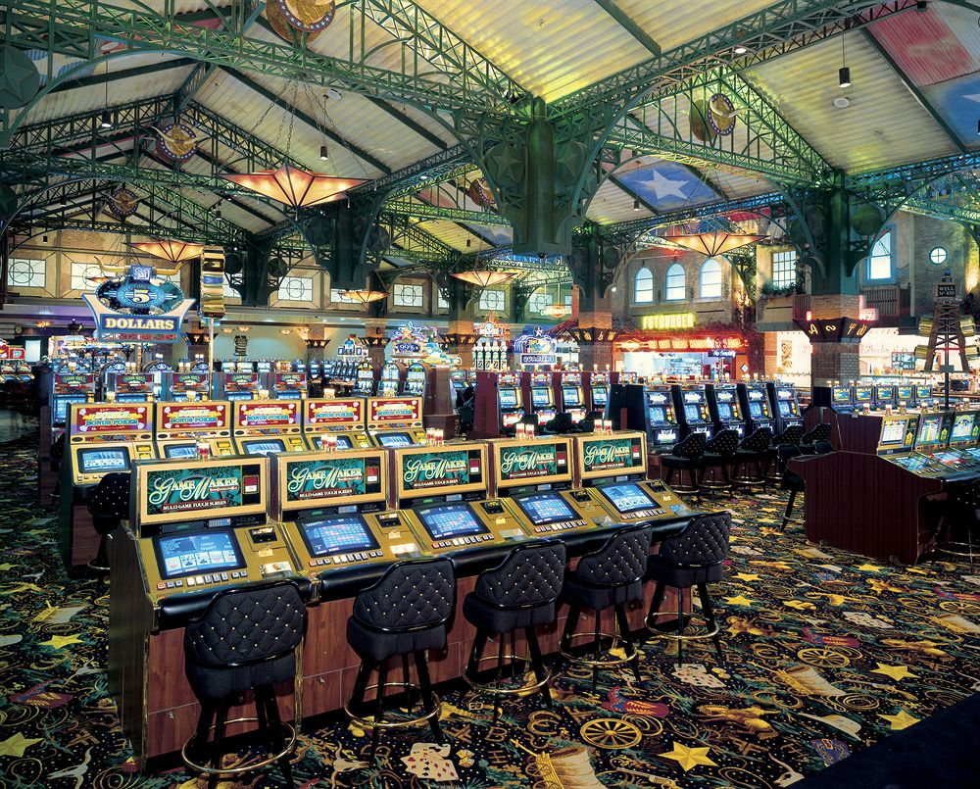

Slide 60

Works for Java

Slide 61
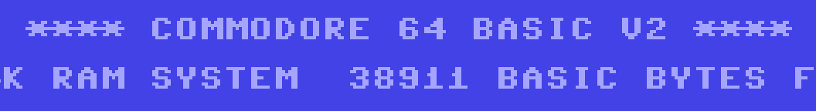
Works for Basic

Slide 62
Works for Pascal
Pascal

Slide 63

Works for C#
Pascal

Slide 64

Why not C++?
Pascal

Slide 65
Inheritance from C
Started before build systems
Did not standardize one
People forked and innovated
=> zoo of tools & inscrutible build solutions
C++ just went with this

Slide 66
How do you make a prescriptive solution work?

Slide 67
Prescribe the status quo
Prescribe what we already do
  in a structured way
  Make everything derivable from the code
  Allow the user to override
    but only where we must allow variation

Slide 68
Standardized project layout
Per component
  src
  include
  test
  doc
  examples
  ...

Slide 69


Slide 70
Pitchfork proposal by Colby Pike
https://ol.reddit.com/r/cpp/comments/996q8o
Take the current defacto standard
Codify it
Tweak it where you must
https://github.com/vector-of-bool/pitchfork

Slide 71
What this offers to tools
Warning people for relying on implementation details
Implicit "at home" feeling in a new code base
Automatically detecting dependencies
→ Zero-configuration project layout information

Slide 72
Dependencies
Compile time
Link time
Run time

Slide 73
Compile time
#include <pixel.hpp>
import std.io;

Slide 74
Link time
extern double d;
void f();

Slide 75
Runtime
Shared libraries
Plugins
Database links
Operating system functions
External hardware
...

Slide 76
Dependencies
Compile time is better than link time
  Detectable dependencies are good
Link time is better than run time
  Breaking a build beats having complaining customers

Slide 77
Manually specified
target_link_libraries
Relative or absolute includes work around this
Overspecified
Underspecified

Slide 78
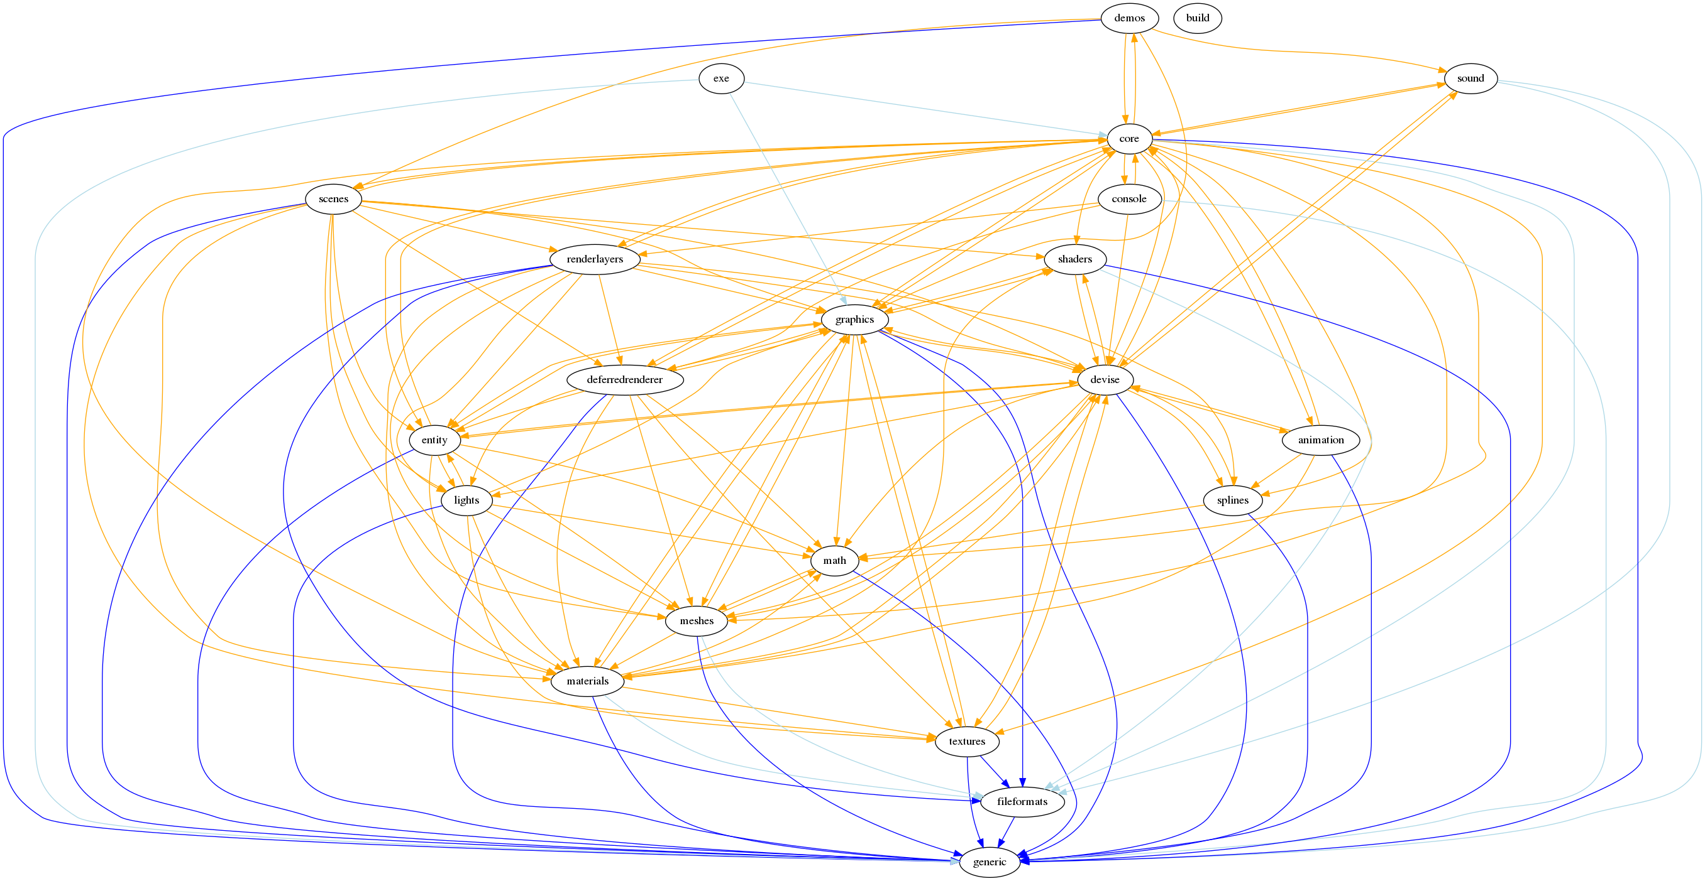

Slide 79


Slide 80
Humans
Humans
  Smart
  Fallible
  (error rate >2%)
Computers
  consistently dumb
  very consistent
  (error rate < 0.0000000001%)

Slide 81


W
W
W
E
E
T
Write Everything Twice

Slide 82
Not hardcoding inferred data
==
it's up to date

Slide 83
Cpp-dependencies
Read all your code
  Extract includes
  Extract imports
Derive what depends on what

Slide 84
Cpp-dependencies
Discover transitive dependencies
We know included files
  Who includes them
  What include path they need

Slide 85
Cpp-dependencies
Component-wise thinking
  Gives us component roots
  CMakeLists.txt location also works

Slide 86
Cpp-dependencies
We know component locations
We know all constituent files
We know public and private dependencies
We know public and private include paths
This is 95% of what your build needs...

Slide 87
Cpp-dependencies at TomTom
TomTom proprietary code base
  7M LoC
  500 components
  Lot of test coverage
2012 4-core laptop with sufficient memory
Expectancy: Should be able to match C preprocessor in speed

Slide 88
Cpp-dependencies at TomTom
2s run time with hot cache
SSD speed limited with cold cache
Interactive analysis
Cycle detection & prevention
Autogenerating cmakelists
  Last time I checked we did about 60%

Slide 89
Cpp-dependencies at TomTom
MeetingC++ talks in 2016 and 2017
So how to make this into a build system?

Slide 90
Evoke
A simple solution for the build system problem
Evoke on Merriam-Webster:
  1 : to call forth (or up)
  2 : to re-create imaginatively

Slide 91
Basic idea
Take
  Cpp-dependencies
  Cmake with fully generated build files
  Ninja to build something
  (Package manager to find needed packages)
Roll that into one

Slide 92
Later goals
Run continuously
Cross-compile for other platforms

Slide 93
Bugs in all build systems now
Race conditions
  Save a file while it's being used for a compilation
    the compile timestamp for object file will be *after* source file
    Won't trigger rebuild if it was successful
    Will cause very hairy bugs if you continue
  Solution: When done with compiling, pre-date the file to the start of compilation

Slide 94
Bugs in all build systems now
Incremental builds hide warnings
  Files with warnings build successfully
  Incremental build skips them
  Warnings are hidden
This is why -Werror is popular.
Solution: Cache warnings & re-emit if not rebuilding
  Breaks time-dependent commands

Slide 95
Design
Take all includes and imports, derive file-level dependencies.
  Ask package manager for packages corresponding to missing files?
  If the package manager did something, rebuild the tree including those packages.

Slide 96
Design
Translate file-level dependencies to component-level dependencies (like cpp-dependencies)
Translate the components and dependencies into command lines for a given target with file-level dependencies (like CMake)
Invoke the low-level build runner to handle these (like Ninja)
  Is currently built-in, but could be externalized to Ninja, Make or something like it

Slide 97
Current limitations
Derived dependencies from includes and imports
Imperfect parser
  >99.99% recognized though
There is the 5% that cannot be done.

Slide 98
The ifdef problem
#ifdef X
#include "file1.h"
#else
#include "file2.h"
#endif

Slide 99
Current limitations
Toolchain switching (Clang)
Modules is completely untested.
  Implemented as per current TS
  Current Clang matches the design; I just haven't gotten around to it.
  Does not include this weeks’ changes

Slide 100
Current limitations
Untested implementation
  Android
Unimplemented
  OSX
  Windows
  iOS
  No reason they can’t be, they just aren’t now

Slide 101
Current limitations
Package manager links
  Dependency import is not implemented properly
  Demo uses a tiny stub. The stub conforms to the interface.
  Tested with a self-written package system
    Miles from release quality

Slide 102
Open to contributors
Come talk to me after the talk
Reach out
Even – especially – if you can’t code
https://github.com/dascandy/evoke

Slide 103
Demo
If we have time

Slide 104
Hello World from scratch

Slide 105
Pixel showcase with Evoke

Slide 106
Let’s make the C++ world a
simpler
place

Slide 107
Peter Bindels
TomTom Intl
@dascandy42
dascandy at discord&slack
https://github.com/tomtom-international/cpp-dependencies
https://github.com/dascandy/evoke

